Slide 1
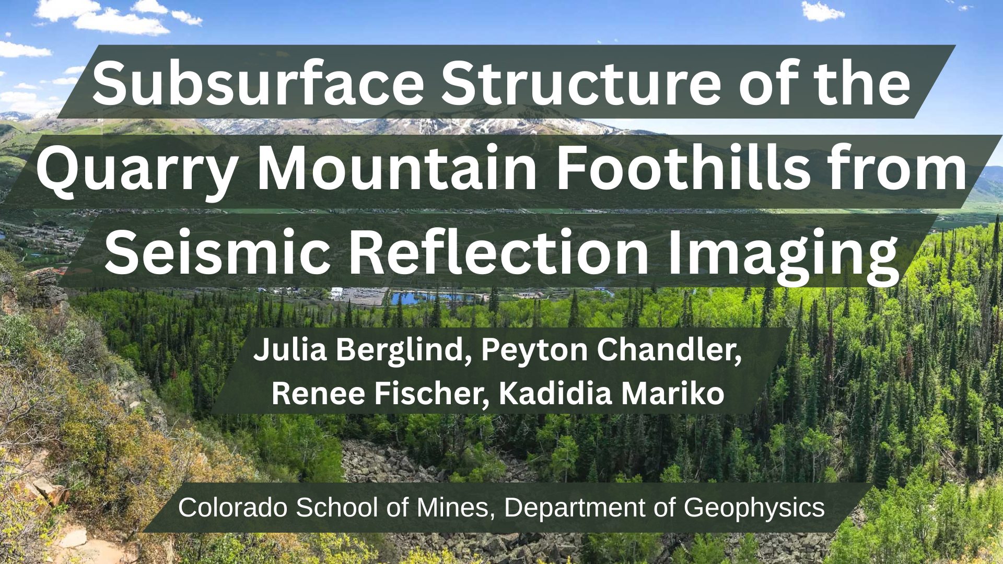
Notes:
renee

Slide 2
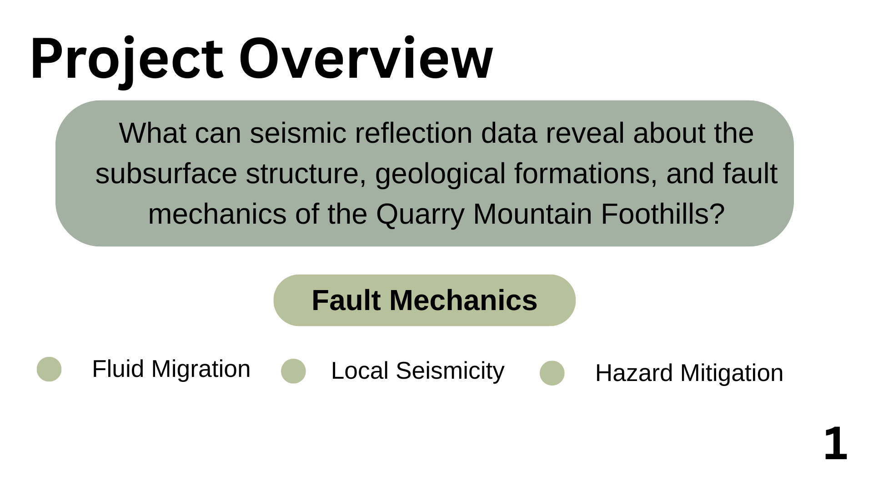
This study aims to use seismic reflection data to image the subsurface structure of the Quarry Mountain Foothills, providing insights into geological formations and fault mechanics.
Steamboat Springs, Colorado is known for its geothermal activity and rich geologic history.
Notes:
Renee
Why SB: High permeability pathways, such as fault zones, enable hydrothermal fluids to travel to the surface from depth at elevated temperatures, driving a cycle of warming and cooling that supplies geothermal springs. Shear zones also contribute to the small-scale seismicity.
Why Steamboat Springs? Hydrothermal pathways and minor seismicity

Slide 3
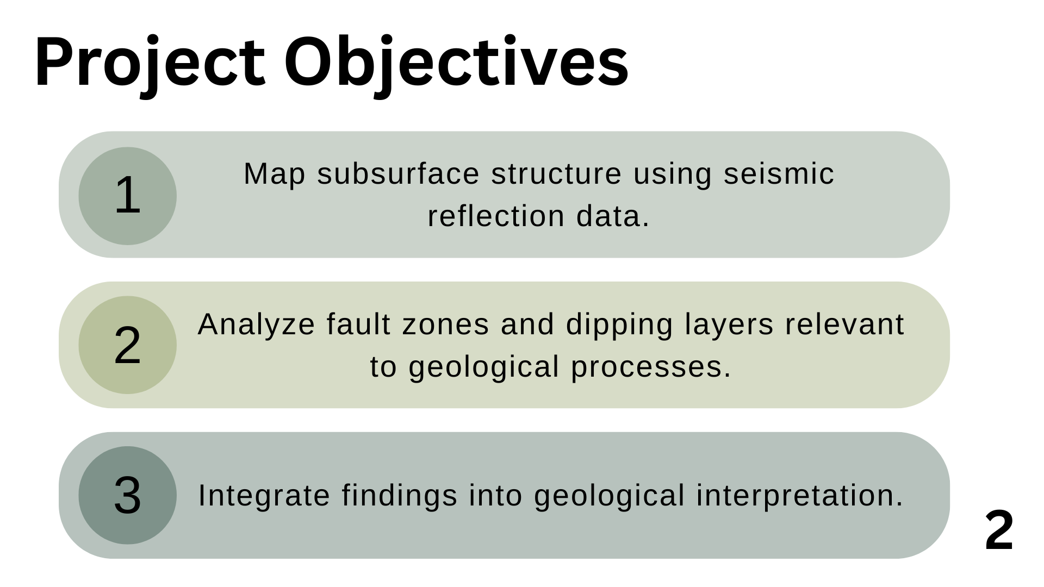
Notes:
renee

Slide 4
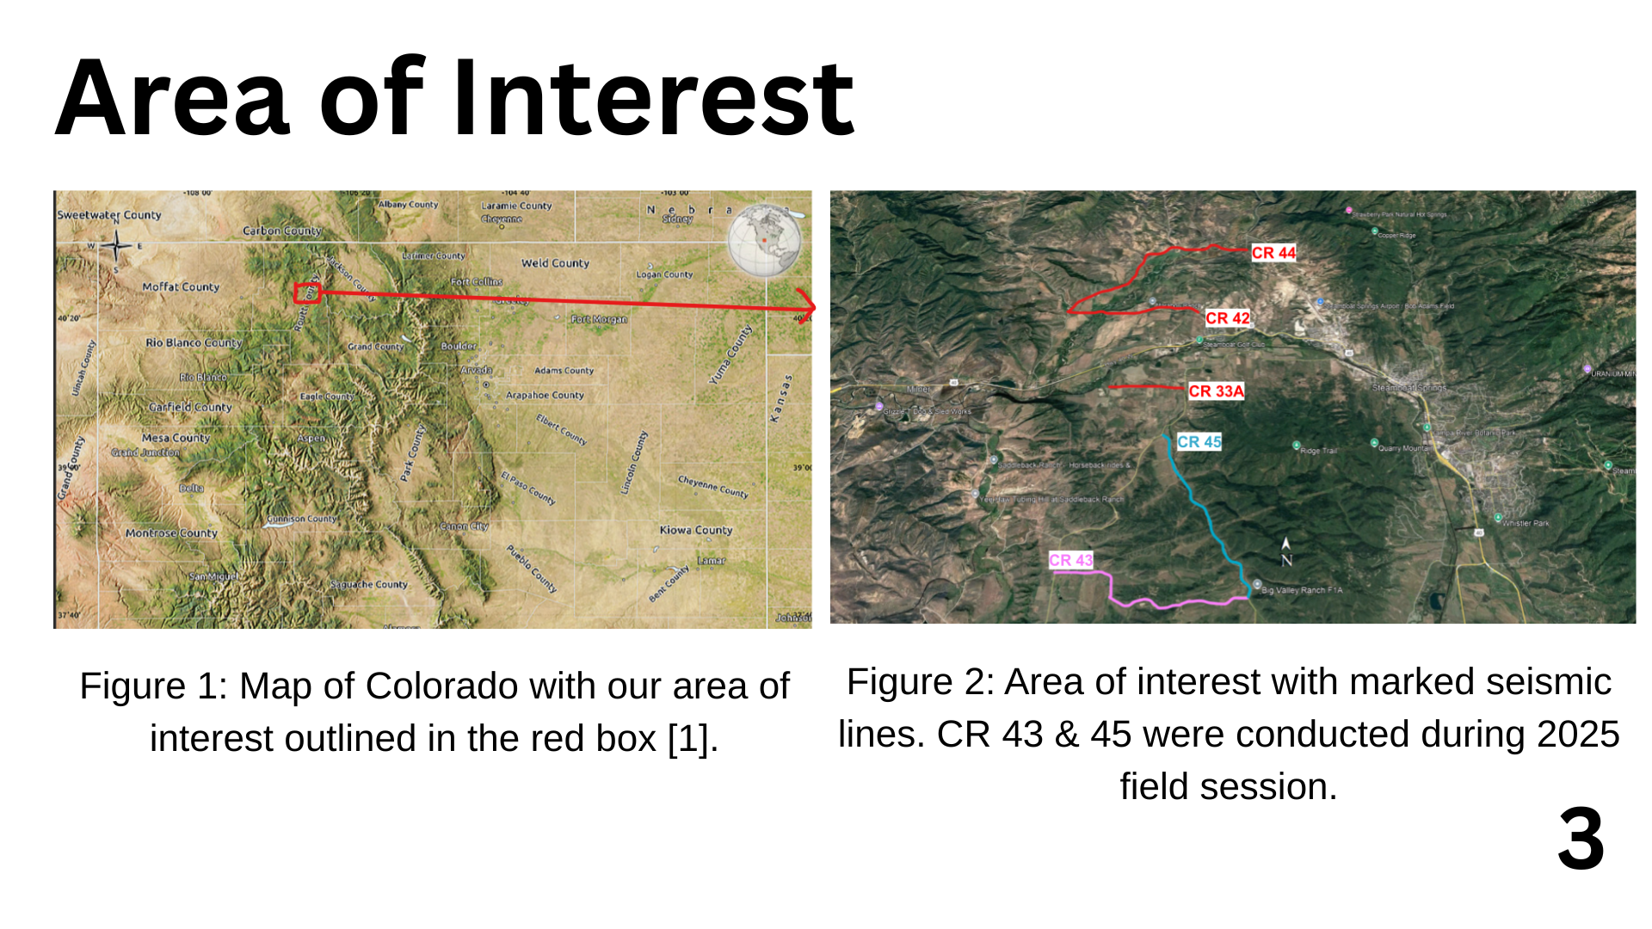
Source: http://www.maphill.com/united-states/colorado/maps/satellite-map/
Notes:
Kadidia
Hello everyone. We studied the Quarry Mountain Foothills in northwestern Colorado, as is indicated by the red box, as reflected in Figure 1.
area has many types of land and complex underground layers so it is best for seismic studies. O
n Figure 2, you can see the whole survey area with the key lines shown such as CR 43 and CR 45.

Slide 5
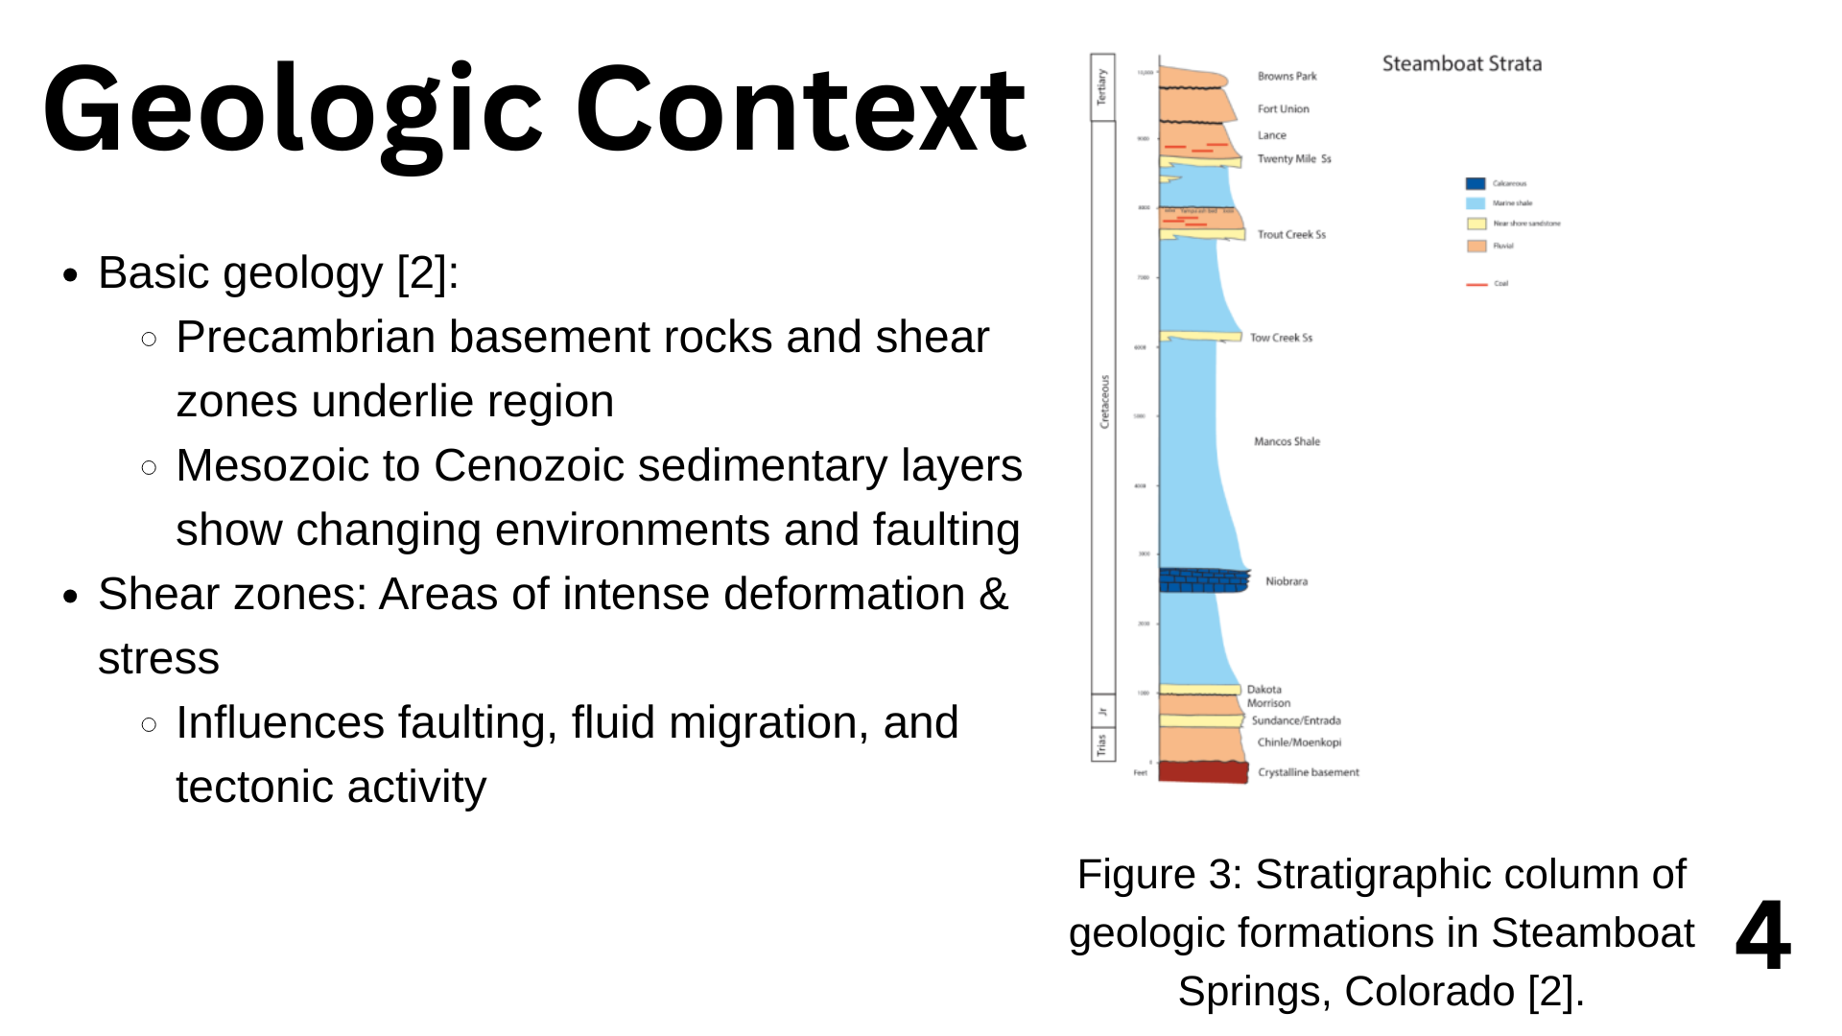
Notes:
kadidia
Image of geologic map in the area
. Precambrian crystalline basement rocks and shear zones are what provide the foundation of this part oF STEAMBOAT SPRINGS
. Each layer in these strata marks a big change in the region’s environment and is heavily determined by regional faults. MORRISON FOMATIONS, BROWNS FROMATIONS AND ETC
WE are interested in shear zones, key areas where a lot of movement and strain occur, because they guide how faults form, fluids flow and tectonic activity happens in these regions. Therefore, seismic reflection imaging works well in this area.

Slide 6
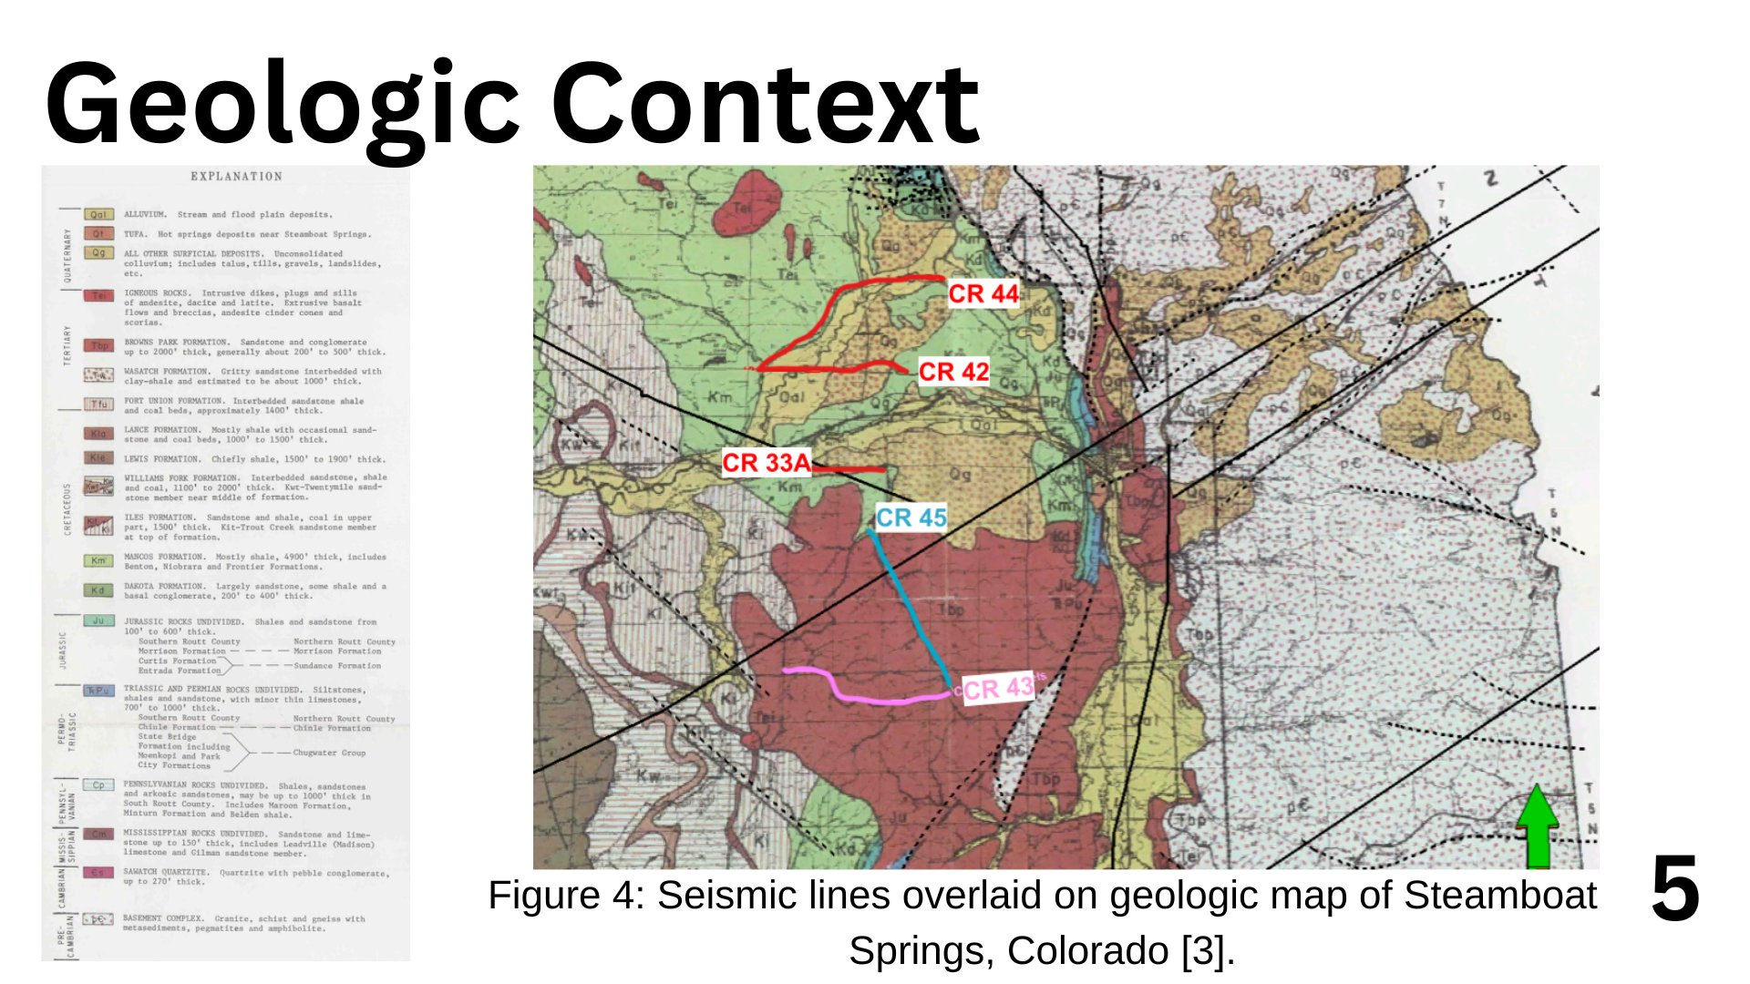
Notes:
Kadidia
You can see in this slide the seismic lines CR 33A, 42, 43, 44 and 45 superimposed on a geologic map for the area of Steamboat Springs.
AND DIFFERENT sedimentary formations
THERE ARE VARABLE GEOGLY ALL OVER STEAMBAOTS

Slide 7
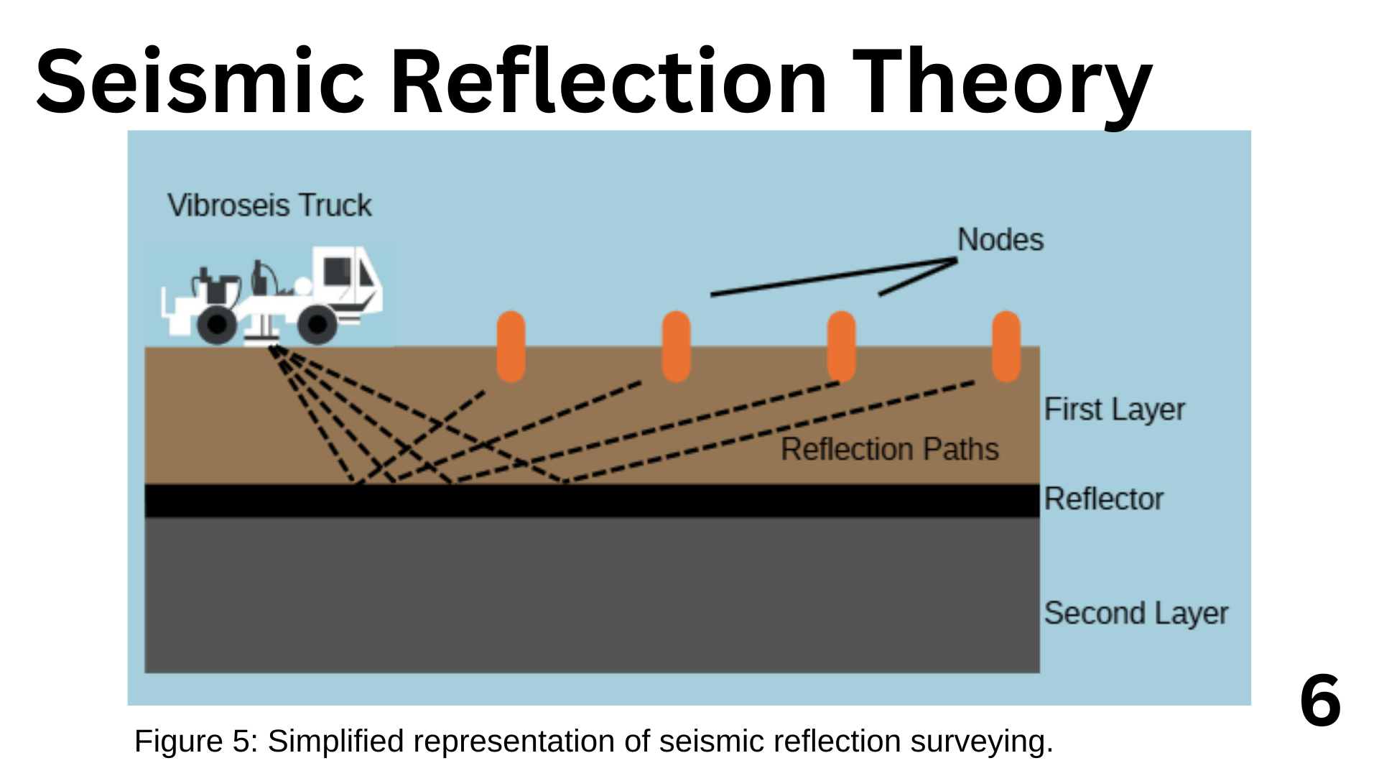
Notes:
renee

Slide 8
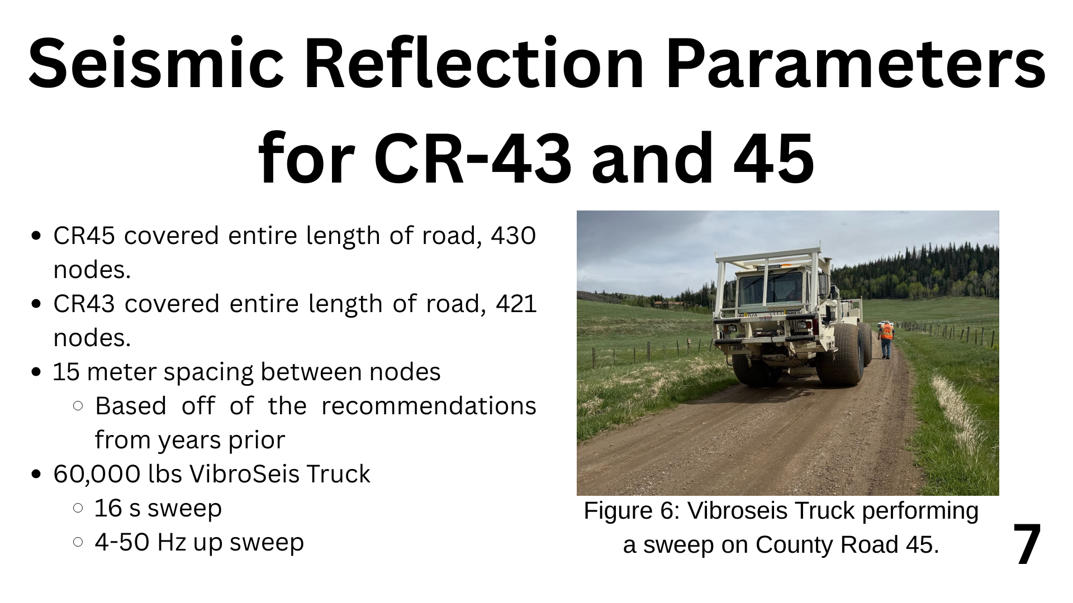
Notes:
peyton

Slide 9
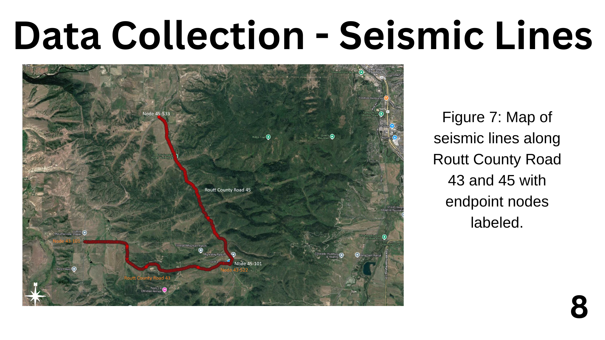

NW
W
SE
E
Notes:
peyton

Slide 10
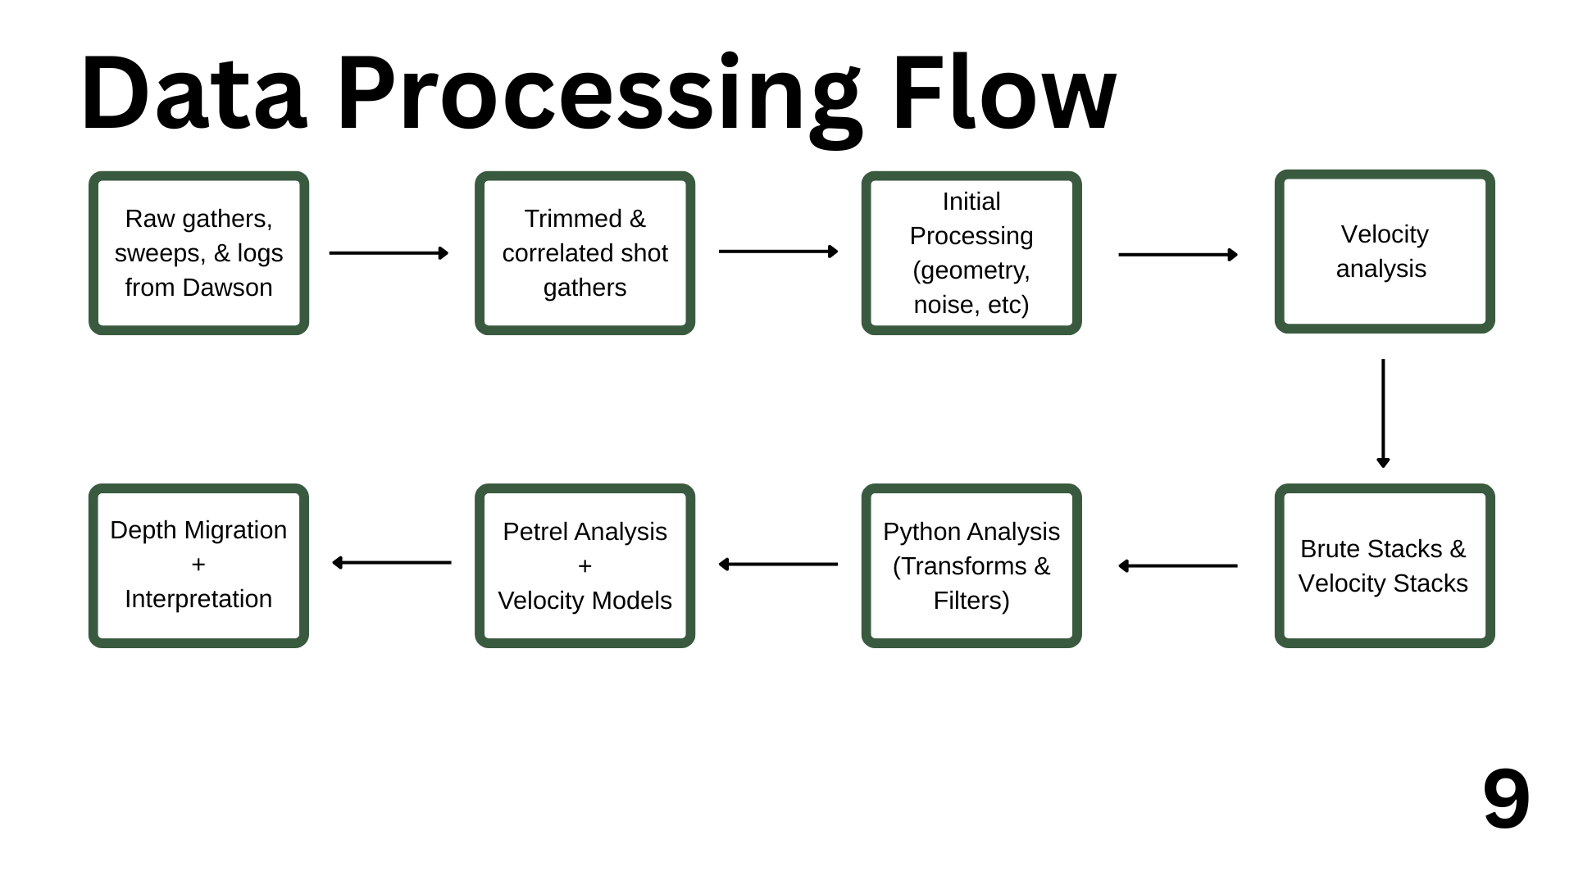
Notes:
julia

Slide 11
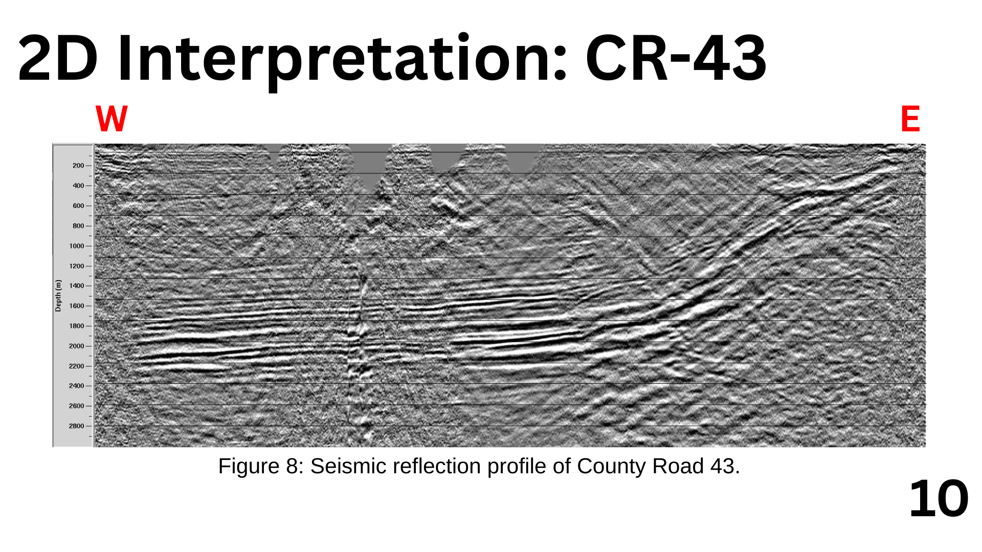
A’
A

Slide 12
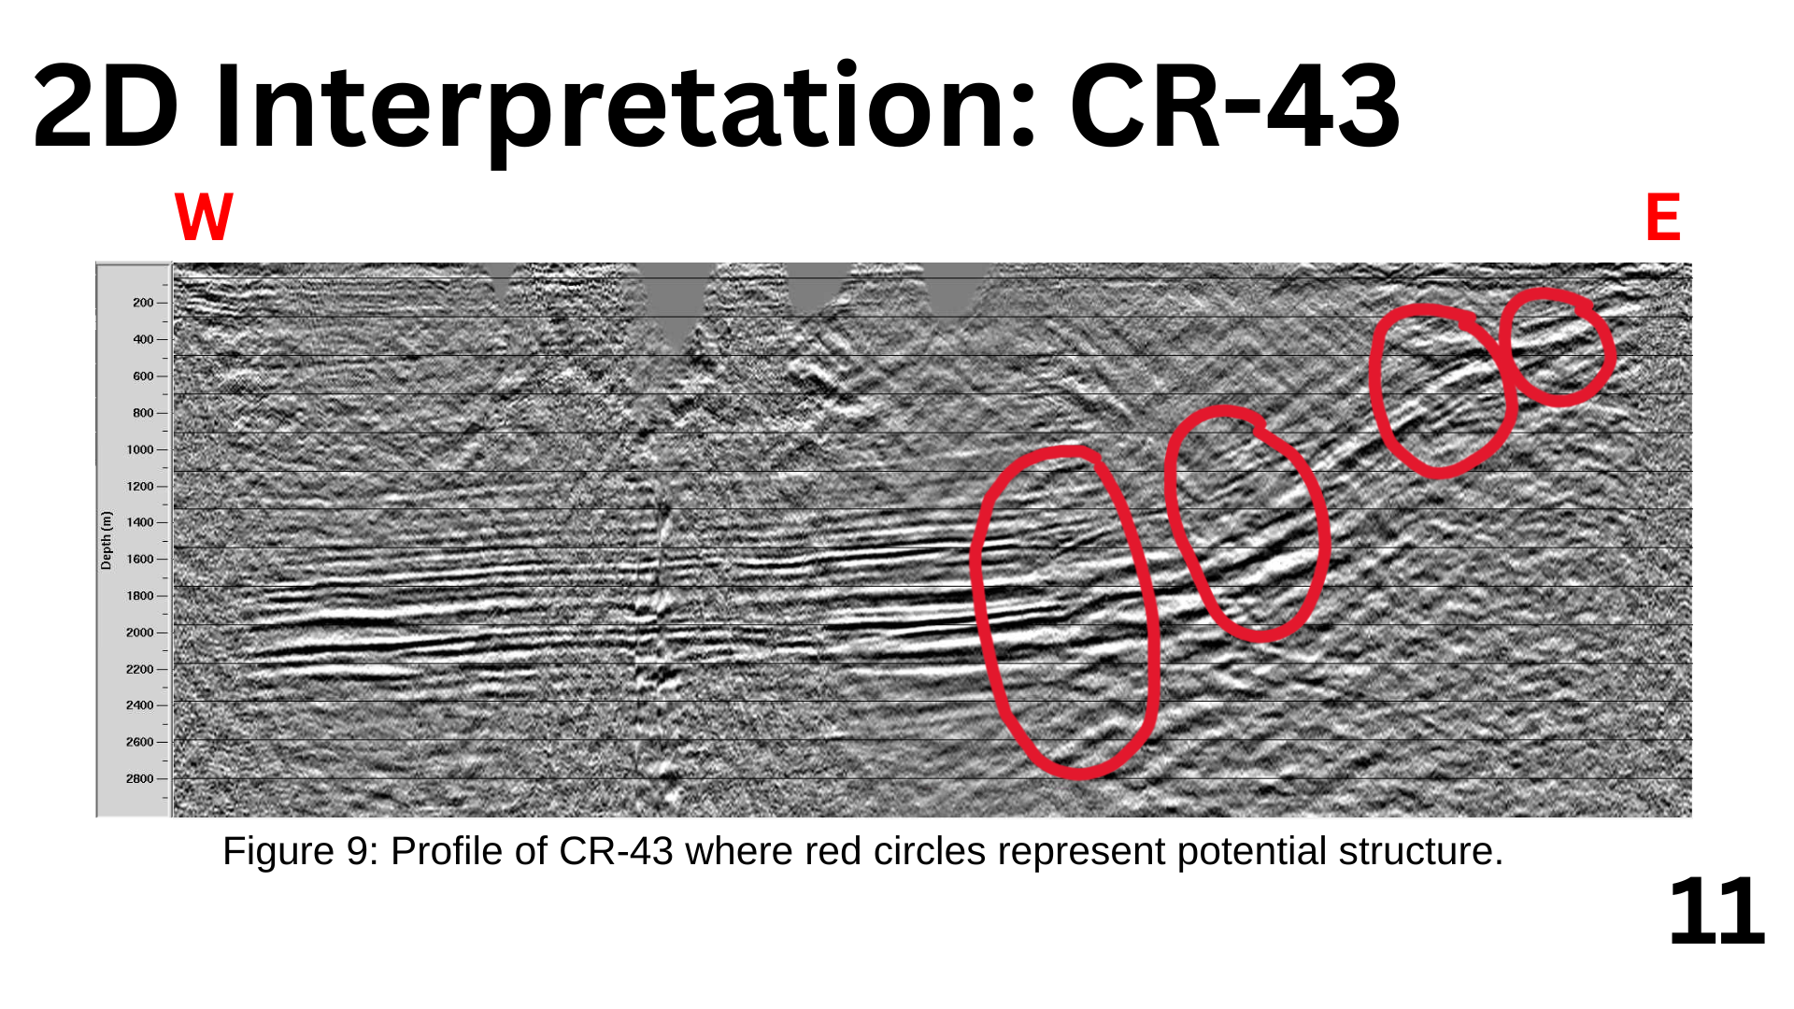
A’
A

Slide 13
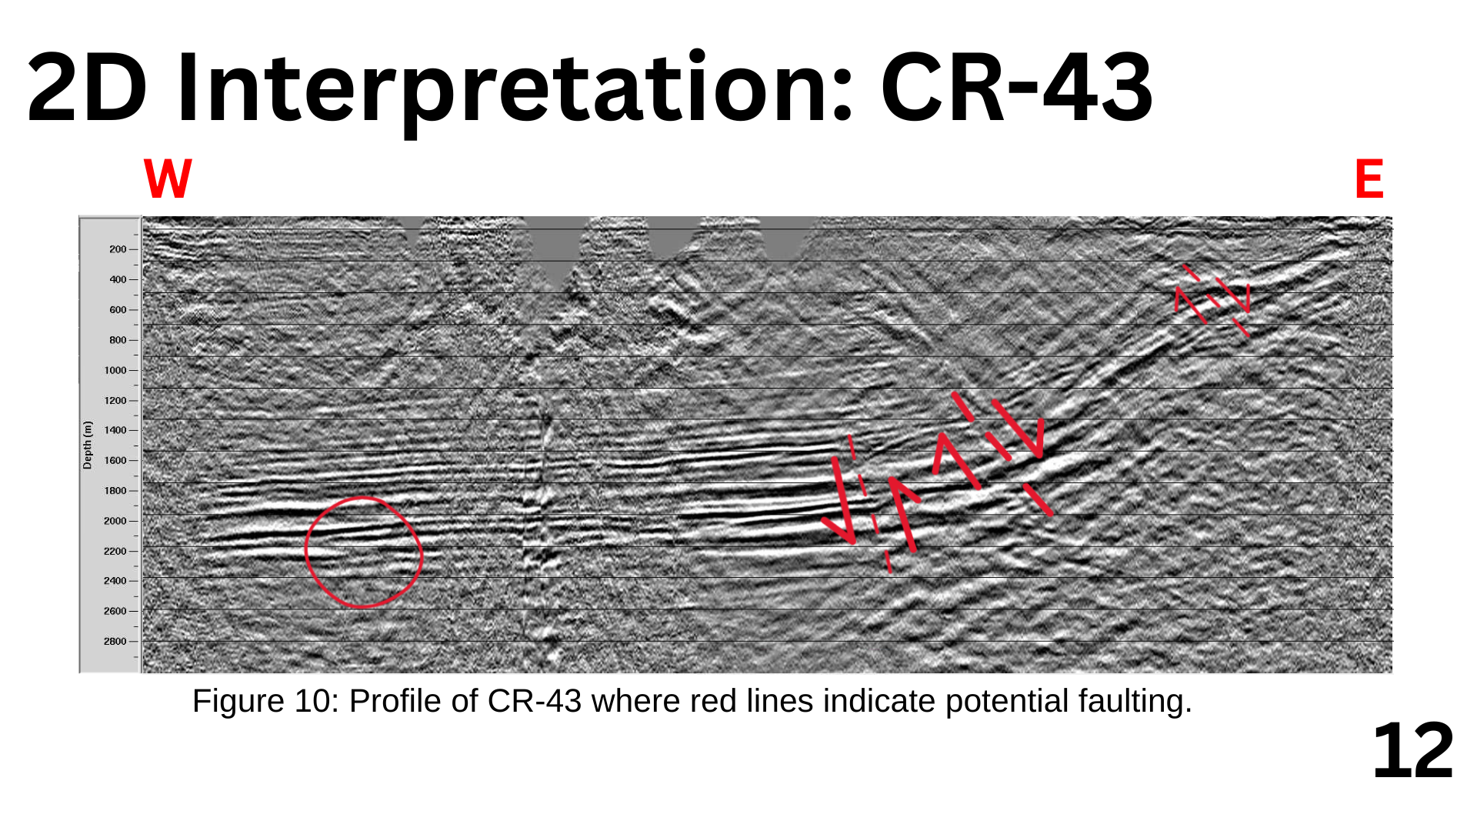
A’
A
Notes:
Julia

Slide 14
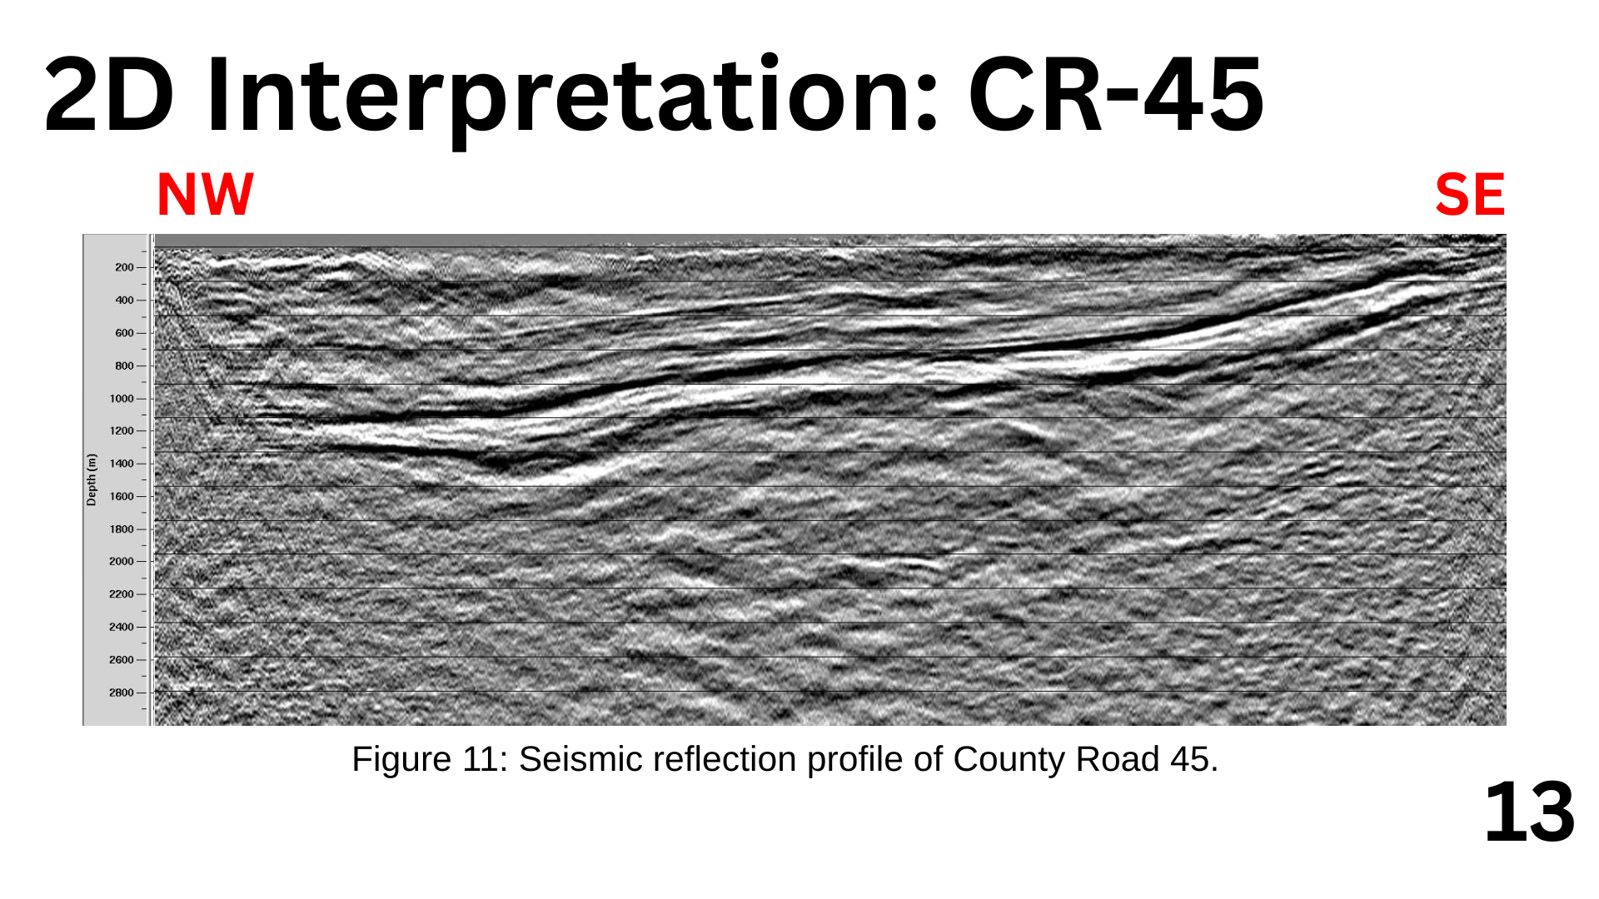
A
A’

Slide 15
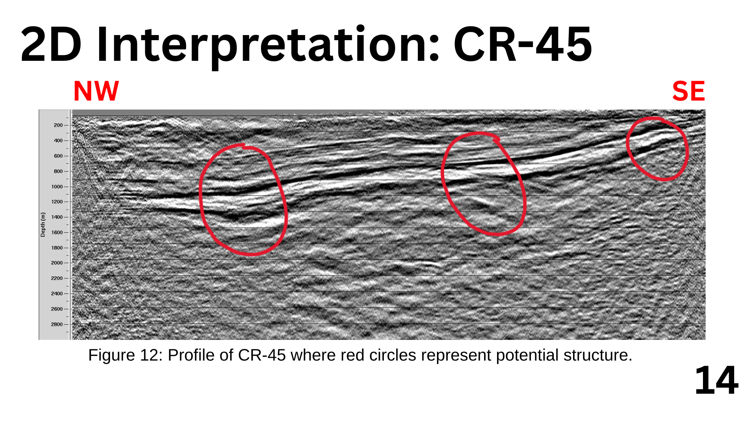
A
A’

Slide 16
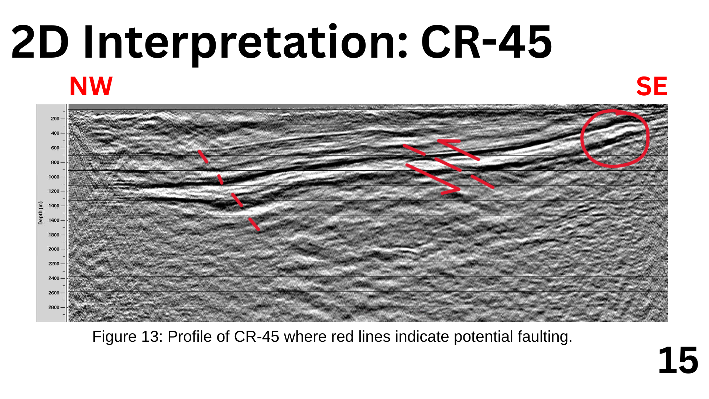
A
A’
Notes:
peyton

Slide 17
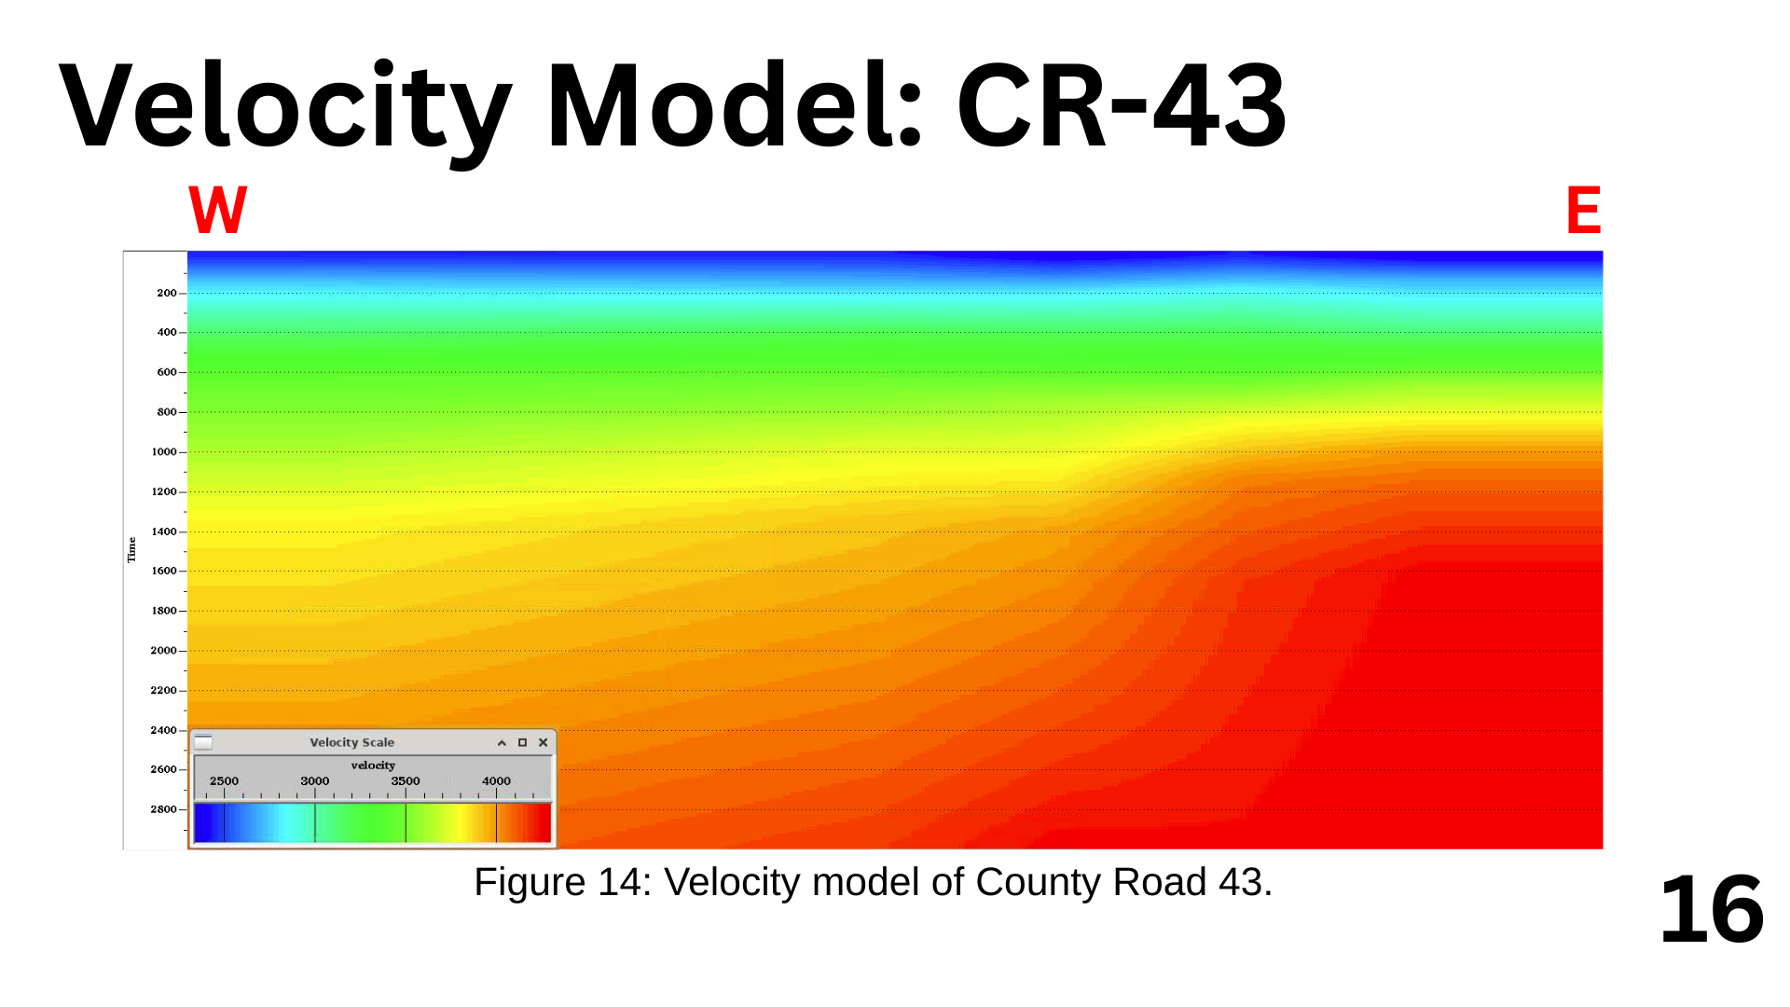
Notes:
peyton

Slide 18
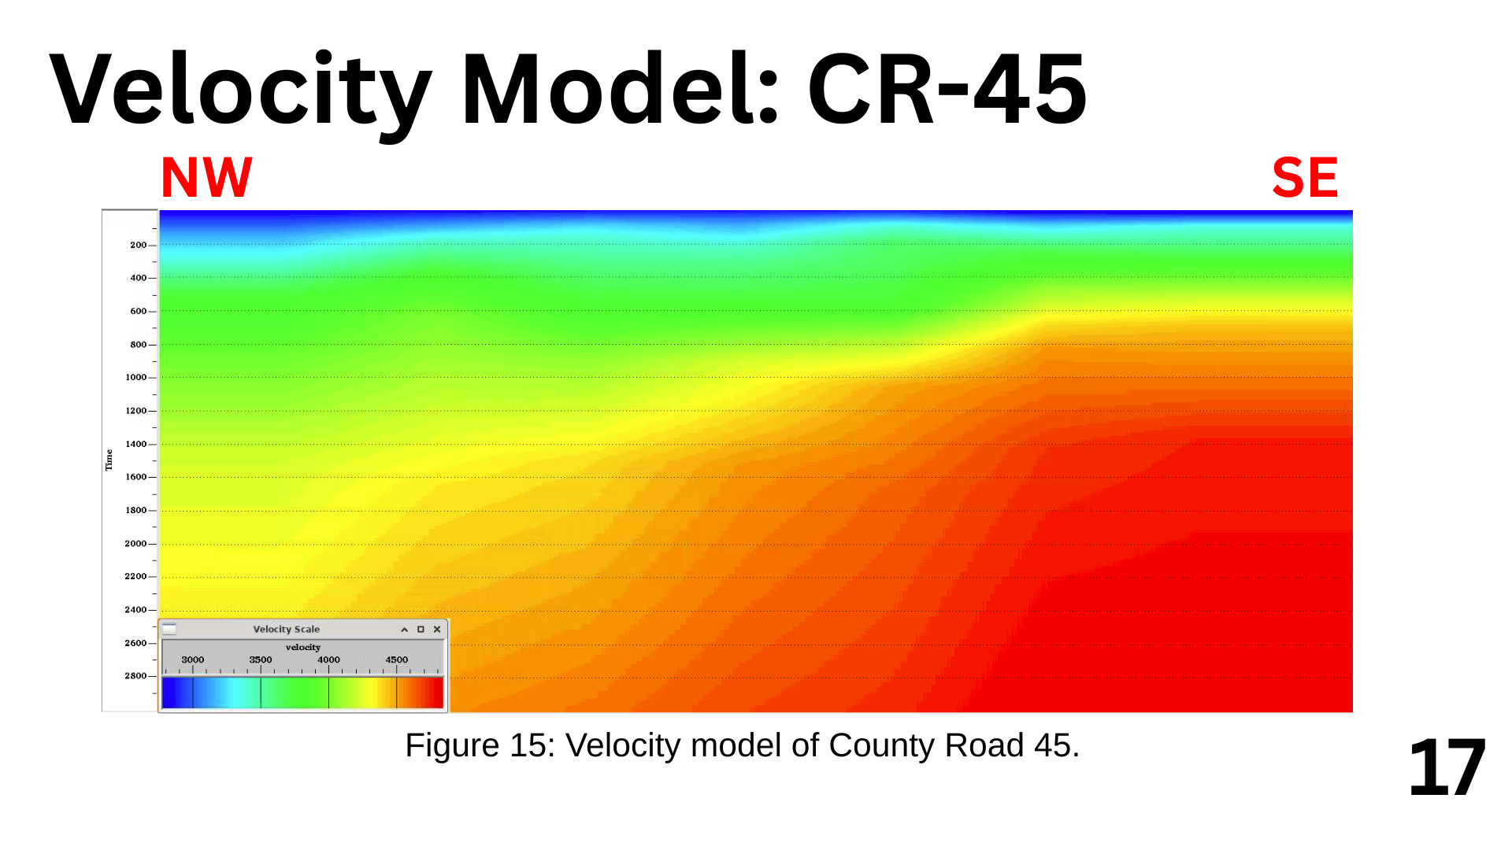

Slide 19
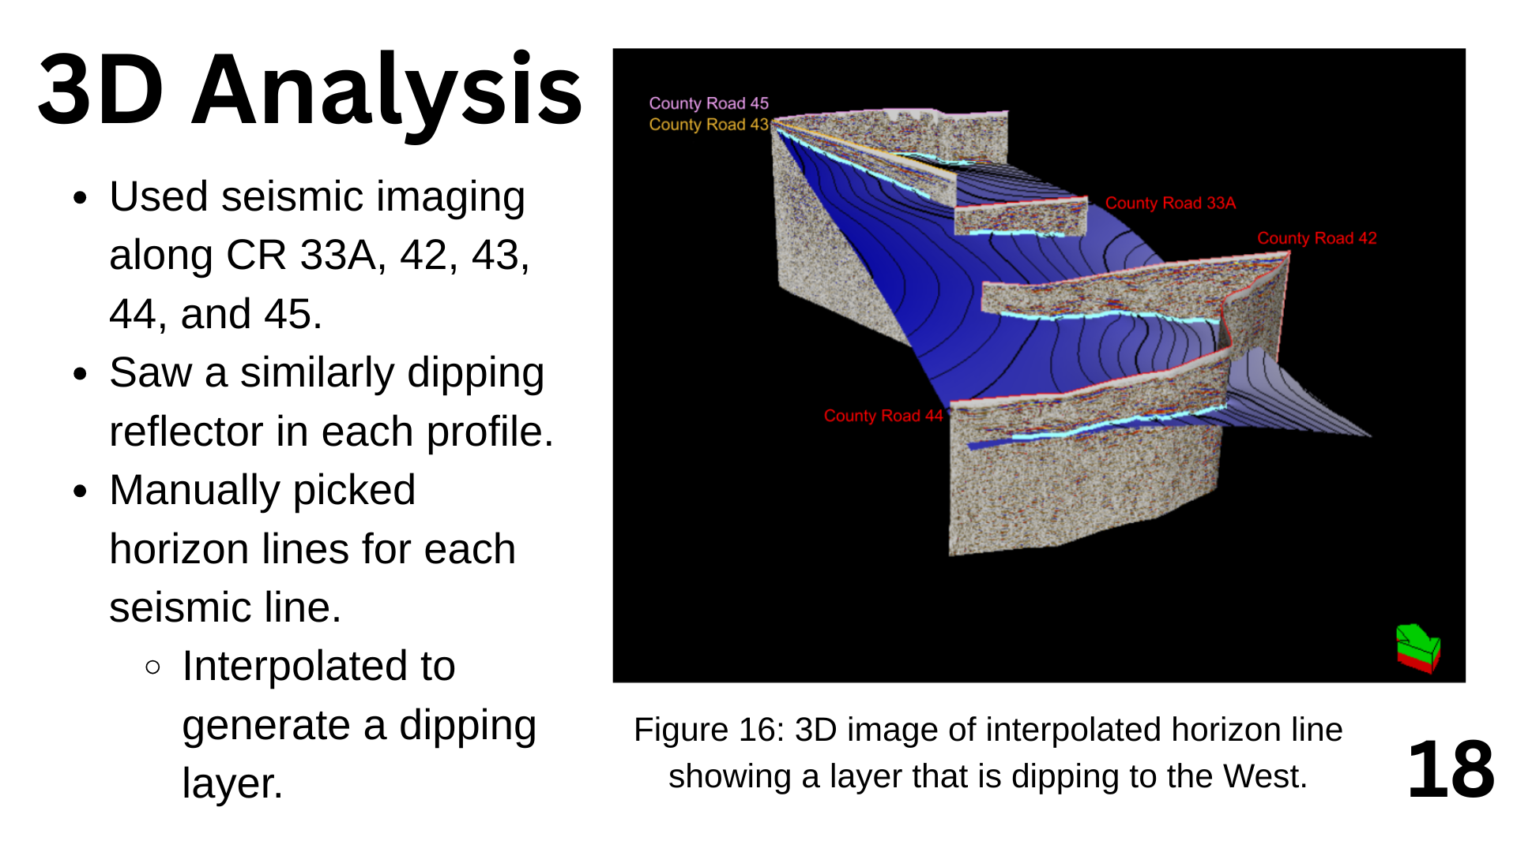

Slide 20
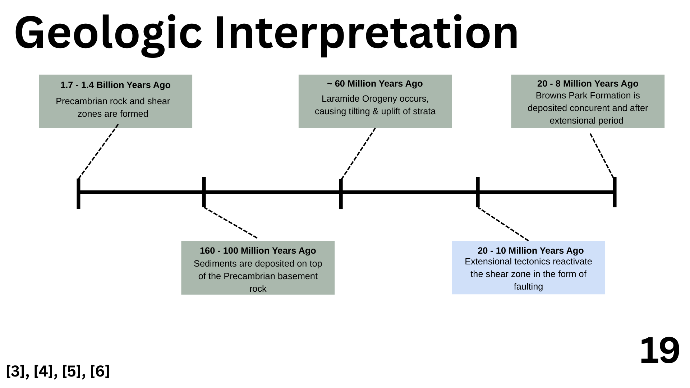
Notes:
Renee
The 3D model integrates seismic reflection lines along CR 33A, 42, 43, 44, 45, showing layered subsurface reflectors.
The curvature and layering pattern supports the interpretation of a regional shear zone, with possible elastic deformation.

Slide 21
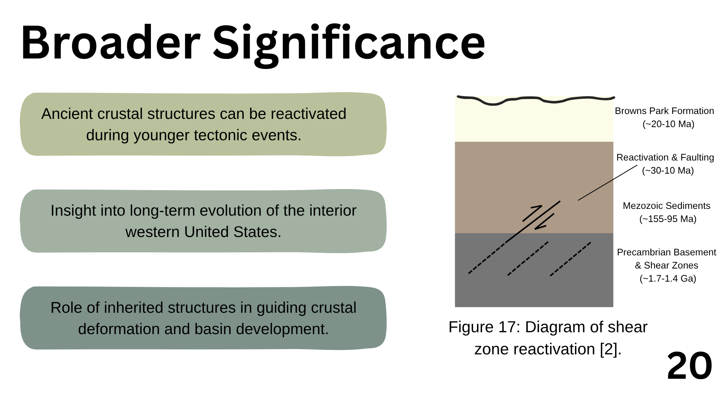
Notes:
Kadidia
the importance of our research beyond the area it happens in.
It greatly affects our view of earthquakes, basins and deformations of the crust in the west
. It can also direct the search for new resources and the evaluation of risks in areas with complicated geological structures.
WE FOUND THE SHEAR=ZONE AND THIS ISN'T JUST STEAMBOAT BUT THE WHOLE CONTENTINATA AND WHERE FAULT ARE DEVELOPING AND HOW WE CAN MITIGATE IT

Slide 22
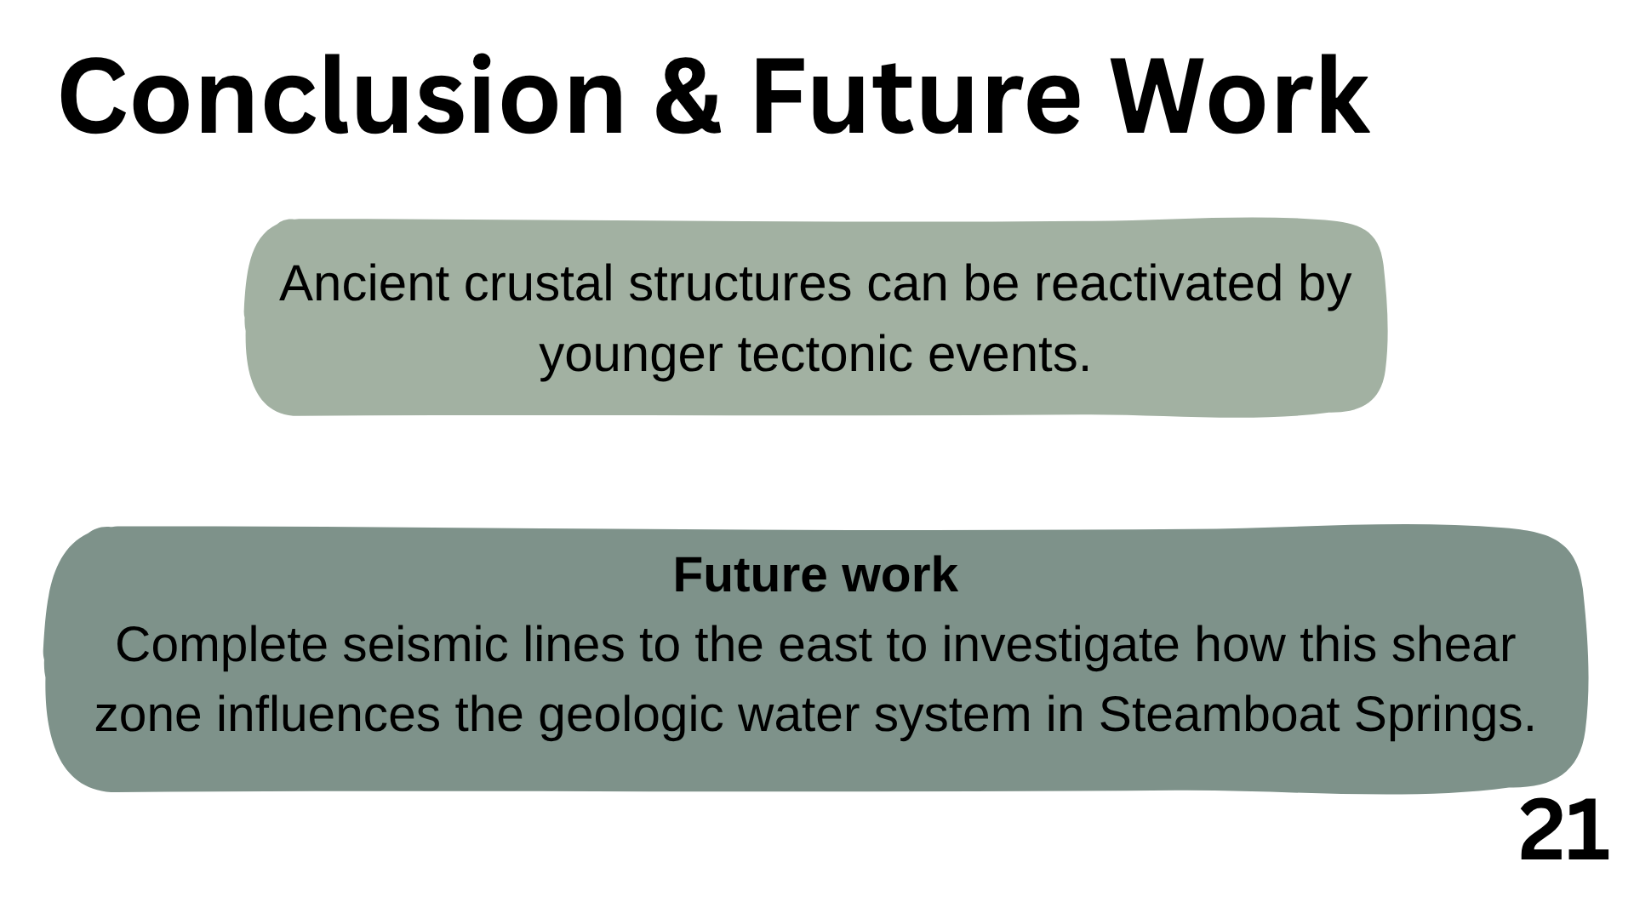
Notes:
kadidia
Concluding, using seismic imaging has shown that ancient crustal structures such as Precambrian shear zones, can be pushed back into activity by modern tectonic pressure. As a result, it emphasizes that the hidden structures join in continuing to shape the world’s topography and fault activity. Our following plan is to push the seismic survey even further east. Through this, we can better understand the effects of the shear zone on groundwater and the wider geology of the area near Steamboat Springs which is revealing for both science and local management of resources

Slide 23

Notes:
julia

Slide 24
